Slide 1

8th Grade Math: Pre-Algebra
Unit 14, Lesson 4 Comparing Theoretical Probability to Experimental Probability Volume 2, pg. 325

Slide 2


Benchmarks
MA.8.DP.2.1
Determine the sample space for a repeated experiment.
MA.8.DP.2.2
Find the theoretical probability of an event related to a repeated experiment.
volume 2, pg. 325

Slide 3
Integrated Mathematical Thinking and Reasoning Standards
MA.K12.MTR.1.1 Actively participate in effortful learning both individually and collectively.
MA.K12.MTR.2.1 Demonstrate understanding by representing problems in multiple ways.
MA.K12.MTR.5.1 Use patterns and structure to help understand and connect mathematical concepts.
volume 2, pg. 325

Slide 4

Learning Target
I can calculate theoretical probability and compare it to experimental probability to evaluate accuracy.
volume 2, pg. 325

Slide 5

Warm-Up
volume 2, pg. 325

Slide 6
14.4.1 Warm-Up: Data Analyst
Ivana Seric has her PhD in mathematics. She works as a data analyst for the Philadelphia 76ers, an NBA basketball team. Data science has changed the game of basketball as players and coaches have been able to use data and analytics, rather than instincts and talent alone, to determine how to improve the game. Data analytics is a growing career field in a world where more and more data are collected and shared through increasing technological means.
What are some ways data analytics has changed the game of basketball?
Explain how other industries might use statistics.
volume 2, pg. 325

Slide 7

Exploration
volume 2, pg. 326

Slide 8

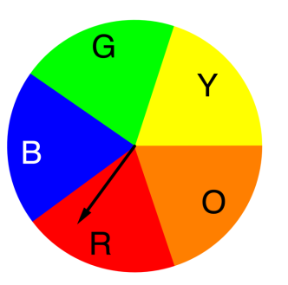
14.4.2 Exploration: Calculating Theoretical Probability
Work with your partner to complete the following simulation involving spinning Spinner B and flipping a fair coin.
Spinner B Coin
As part of a game, Spinner B is spun and a coin is flipped. The theoretical probabilities of events in this random process can be found by determining the sample space using a list, table, or tree diagram.
volume 2, pg. 326

Slide 9
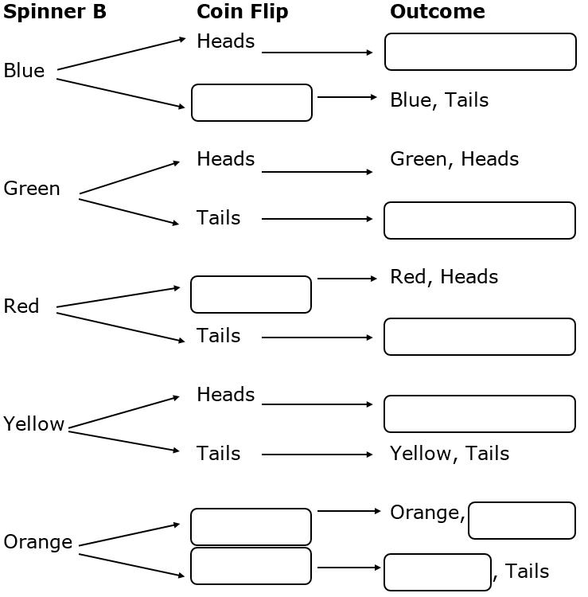
Complete the tree diagram to determine the sample space.
volume 2, pg. 326

Slide 10
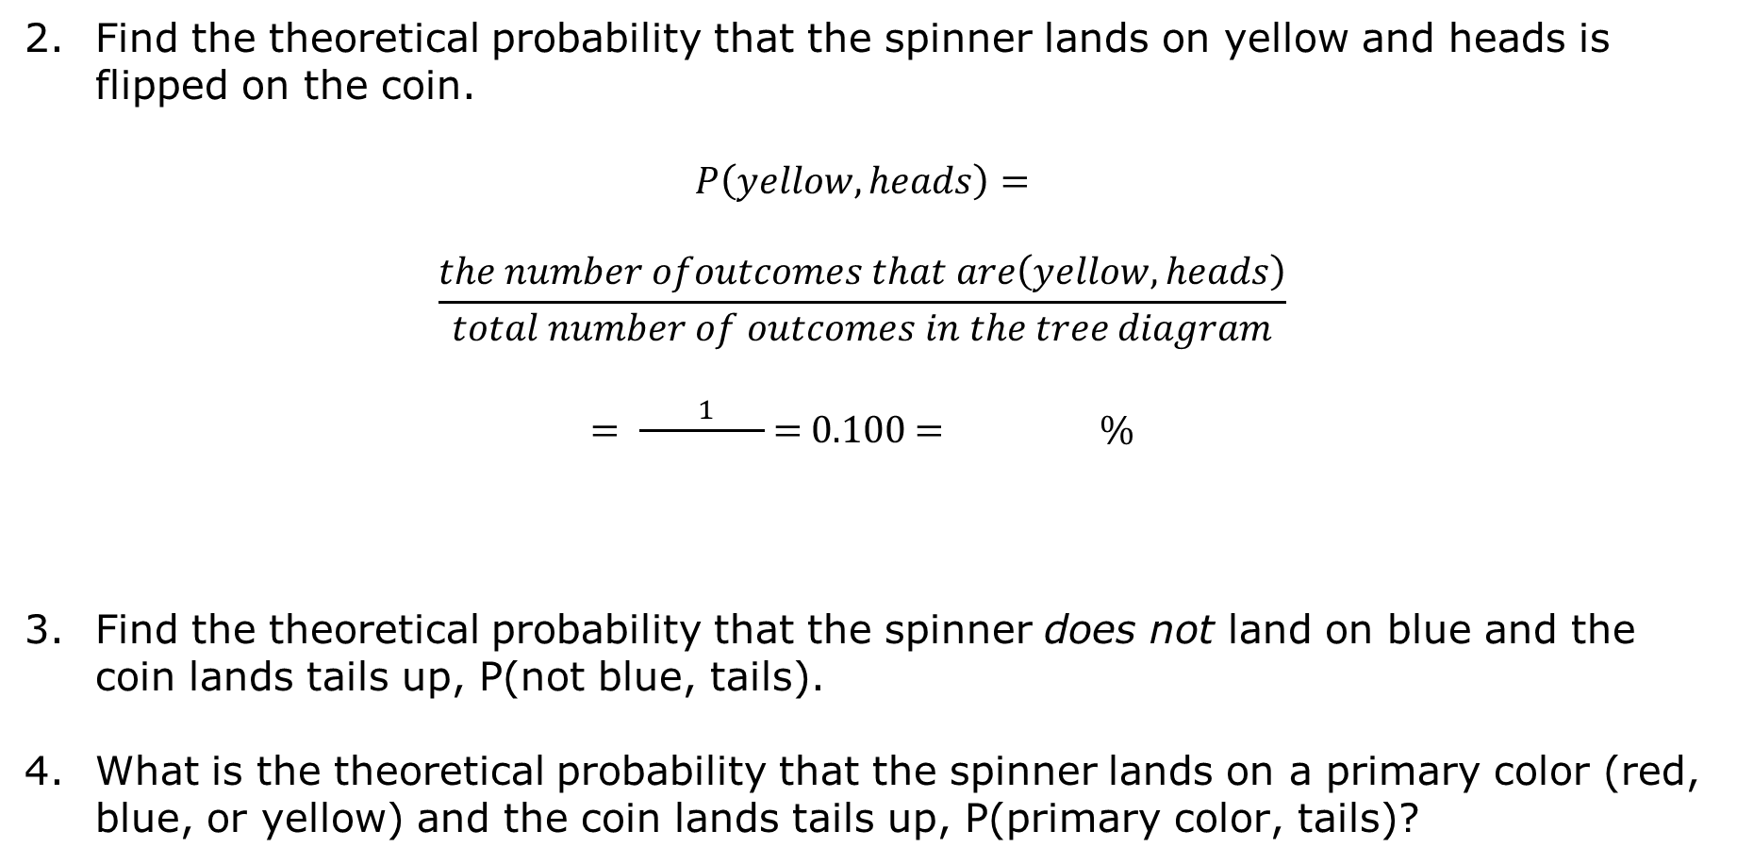
Find the theoretical probability that the spinner lands on yellow and heads is flipped on the coin.
$$P\left(yellow, heads\right)=$$
$$\frac{the number ofoutcomes that are\left(yellow, heads\right)}{total number of outcomes in the tree diagram}$$
$= \frac{ 1 }{ }$= $0.100$ = $\%$
Find the theoretical probability that the spinner does not land on blue and the coin lands tails up, P(not blue, tails).
What is the theoretical probability that the spinner lands on a primary color (red, blue, or yellow) and the coin lands tails up, P(primary color, tails)?
volume 2, pg. 327

Slide 11
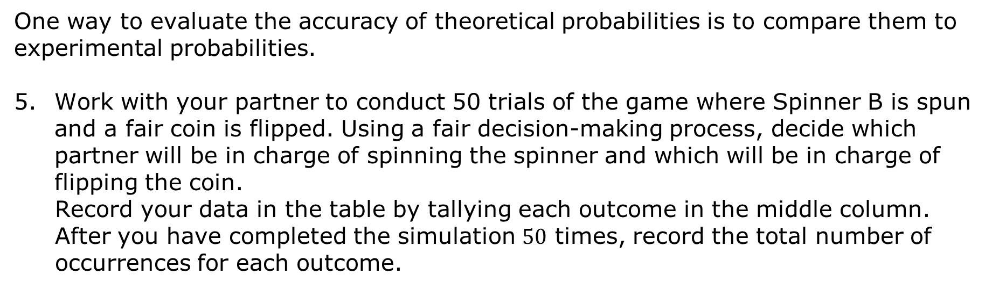
One way to evaluate the accuracy of theoretical probabilities is to compare them to experimental probabilities.
Work with your partner to conduct 50 trials of the game where Spinner B is spun and a fair coin is flipped. Using a fair decision-making process, decide which partner will be in charge of spinning the spinner and which will be in charge of flipping the coin.
Record your data in the table by tallying each outcome in the middle column. After you have completed the simulation $50$ times, record the total number of occurrences for each outcome.
volume 2, pg. 327

Slide 12
Outcome | Number of Times the Outcome Occurs | Experimental Probability of Each Outcome
Red, heads | Total:
Red, tails | Total:
Orange, heads | Total:
Orange, tails | Total:
Yellow, heads | Total:
volume 2, pg. 327

Slide 13
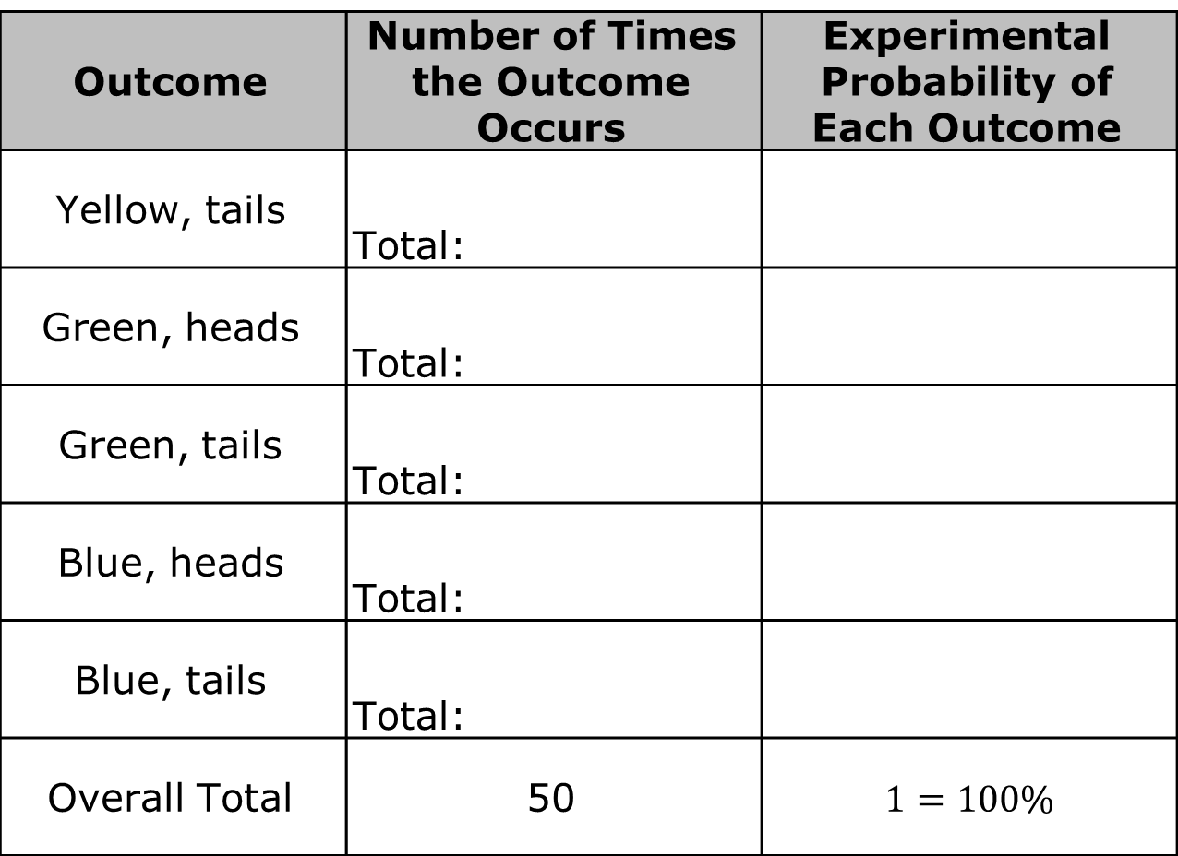
Outcome | Number of Times the Outcome Occurs | Experimental Probability of Each Outcome
Yellow, tails | Total:
Green, heads | Total:
Green, tails | Total:
Blue, heads | Total:
Blue, tails | Total:
Overall Total | 50 | $$1=100\%$$
volume 2, pg. 328

Slide 14
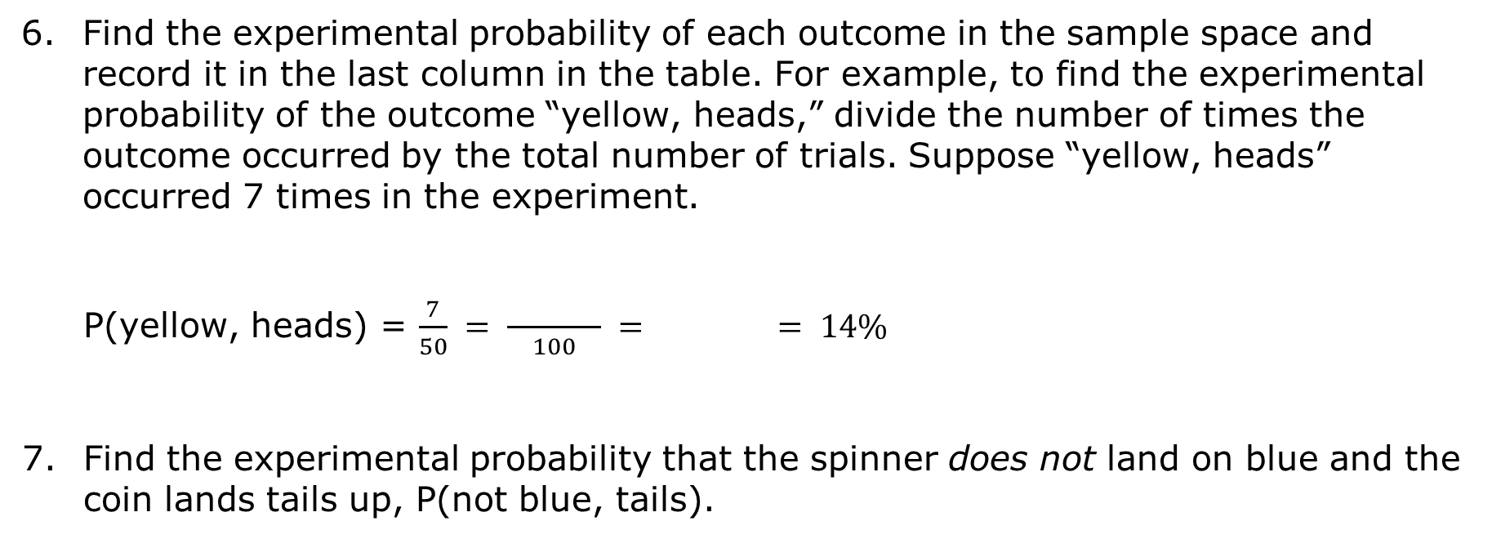
Find the experimental probability of each outcome in the sample space and record it in the last column in the table. For example, to find the experimental probability of the outcome “yellow, heads,” divide the number of times the outcome occurred by the total number of trials. Suppose “yellow, heads” occurred 7 times in the experiment.
P(yellow, heads) = $\frac{7}{50} = \frac{ }{100} = = 14\%$
Find the experimental probability that the spinner does not land on blue and the coin lands tails up, P(not blue, tails).
volume 2, pg. 328

Slide 15
What is the experimental probability that the spinner lands on a primary color (red, blue, or yellow) and the coin lands tails up, P(primary color, tails)?
Explain how these experimental probabilities compare to the theoretical probabilities you calculated using the tree diagram.
Why do you think the experimental probabilities differed from the theoretical probabilities?
volume 2, pg. 328

Slide 16

Collaboration
volume 2, pg. 329

Slide 17

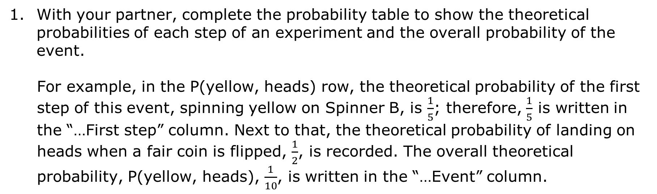
14.4.3 Collaboration: Compound Probability
With your partner, complete the probability table to show the theoretical probabilities of each step of an experiment and the overall probability of the event.
For example, in the P(yellow, heads) row, the theoretical probability of the first step of this event, spinning yellow on Spinner B, is $\frac{1}{5}$; therefore, $\frac{1}{5}$ is written in the “…First step” column. Next to that, the theoretical probability of landing on heads when a fair coin is flipped, $\frac{1}{2}$, is recorded. The overall theoretical probability, P(yellow, heads), $\frac{1}{10}$, is written in the “…Event” column.
volume 2, pg. 329

Slide 18
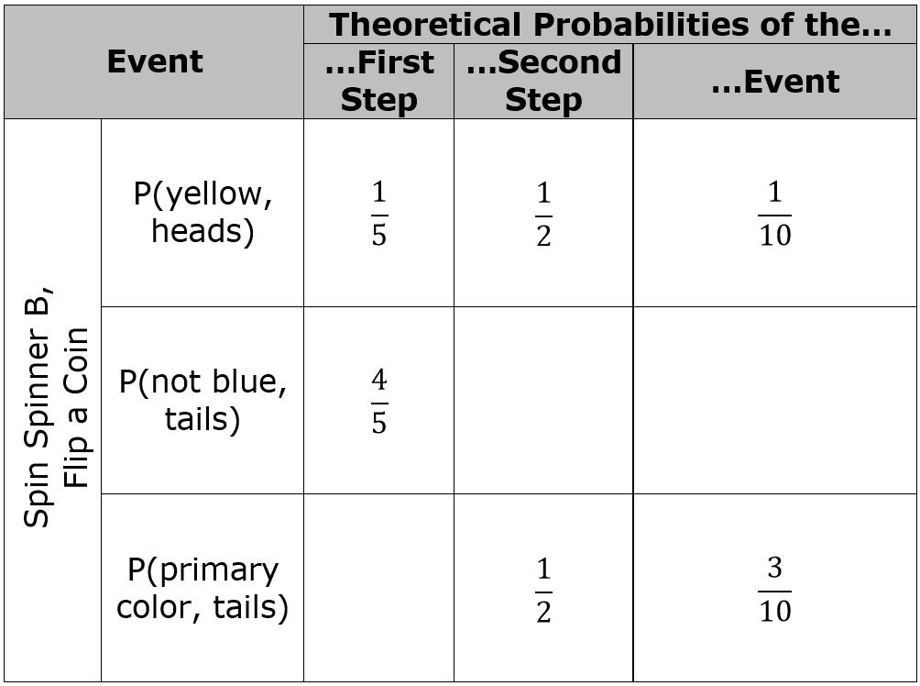
volume 2, pg. 329

Slide 19
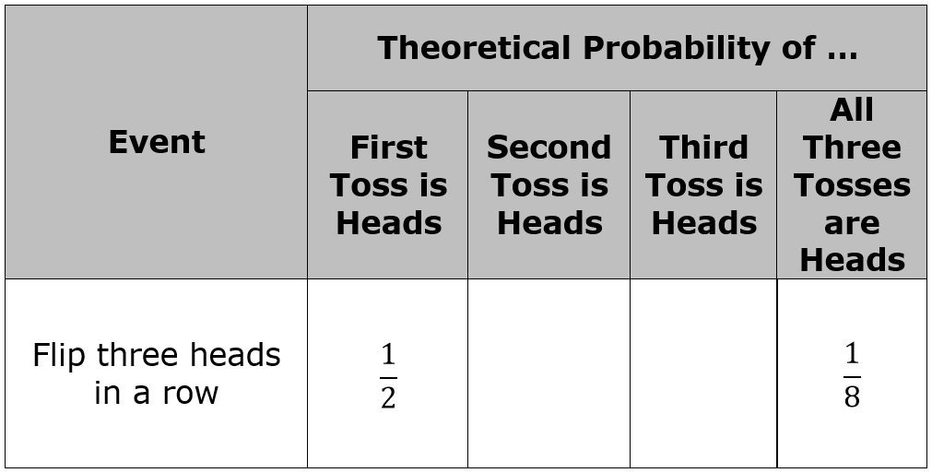
Suppose a fair coin is tossed three times. Complete the table.
volume 2, pg. 329

Slide 20
What do you notice about the tables?
What do you wonder about the tables?
volume 2, pg. 329

Slide 21

Bring It Together
volume 2, pg. 330

Slide 22

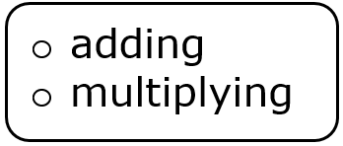
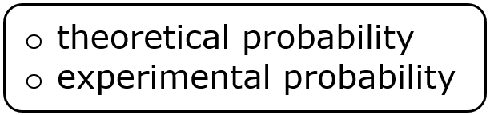
14.4.4 Bring It Together: Calculating Theoretical Probability
The theoretical probability of the outcomes in a
multi-step experiment can be found by
the of the outcome for each step of the experiment.
volume 2, pg. 330

Slide 23
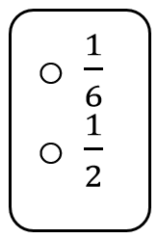
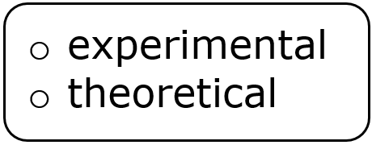
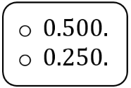
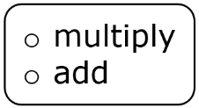
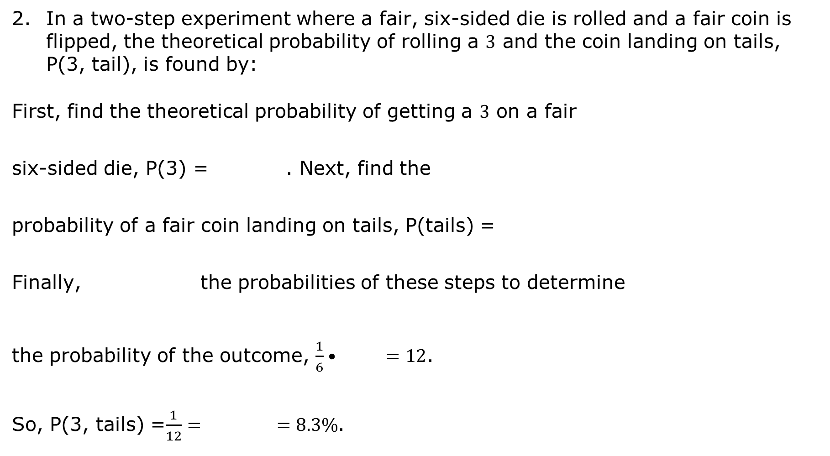
In a two-step experiment where a fair, six-sided die is rolled and a fair coin is flipped, the theoretical probability of rolling a $3$ and the coin landing on tails, P(3, tail), is found by:
First, find the theoretical probability of getting a $3$ on a fair six-sided die, P(3) = . Next, find the
probability of a fair coin landing on tails, P(tails) =
Finally, the probabilities of these steps to determine the probability of the outcome, $\frac{1}{6}• =12$.
So, P(3, tails) =$\frac{1}{12}= =8.3\%$.
volume 2, pg. 330

Slide 24
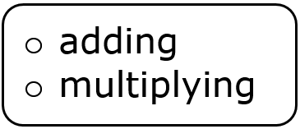
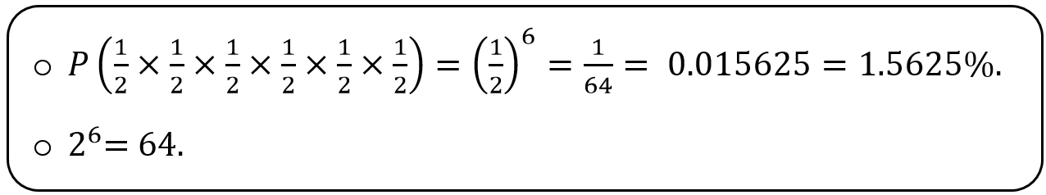
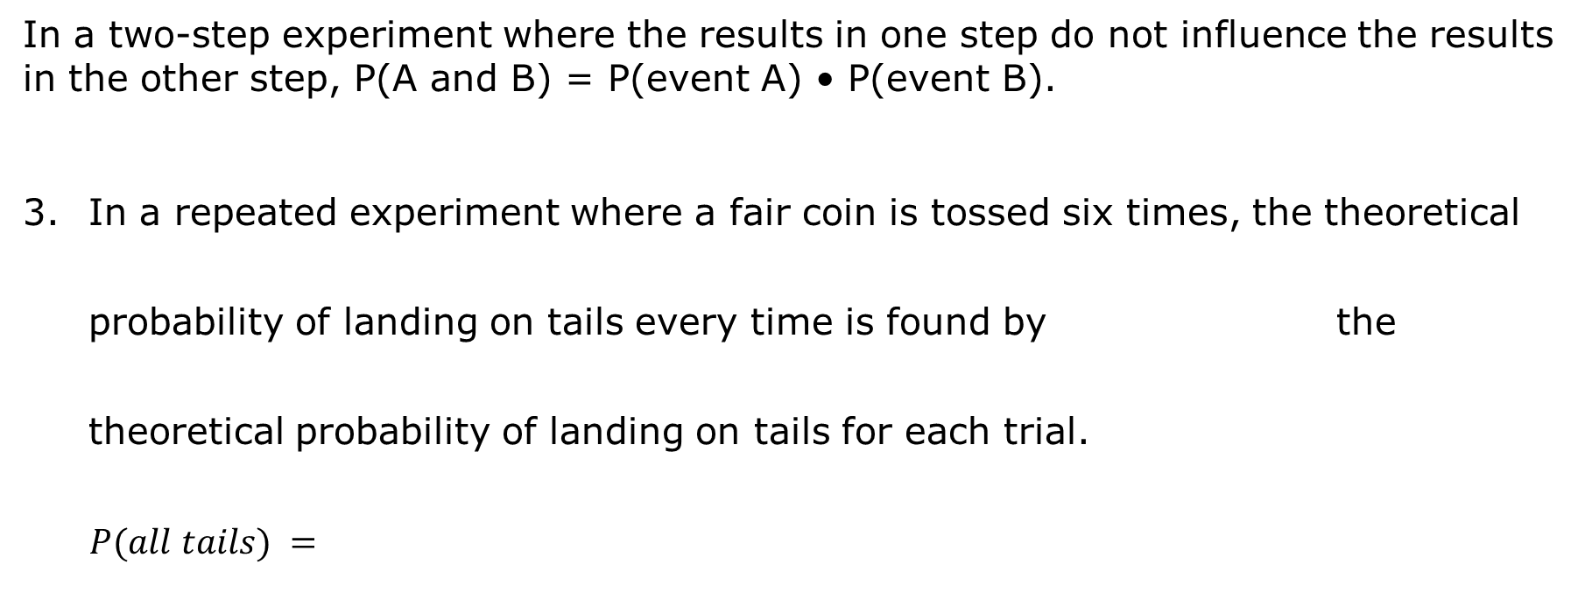
In a two-step experiment where the results in one step do not influence the results in the other step, P(A and B) = P(event A) • P(event B).
In a repeated experiment where a fair coin is tossed six times, the theoretical probability of landing on tails every time is found by the theoretical probability of landing on tails for each trial.
$$P(all tails) =$$
volume 2, pg. 330

Slide 25

Wrap-Up
volume 2, pg. 331

Slide 26
14.4.5 Wrap-Up: Cool Down
Write a short note to a friend who missed today’s class summarizing what you learned.
volume 2, pg. 331

